Slide 1

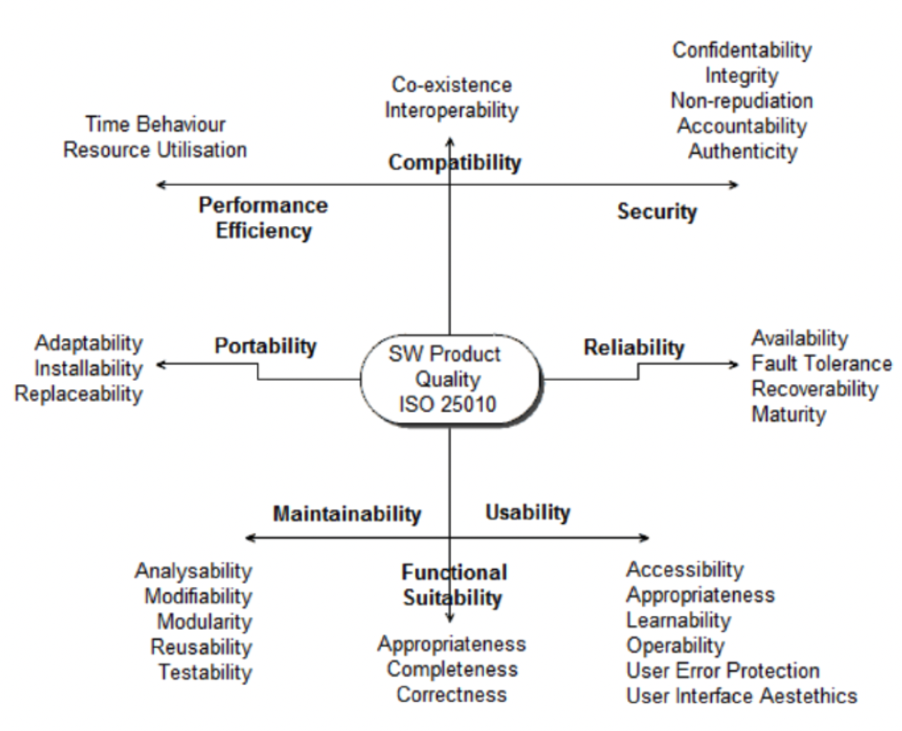
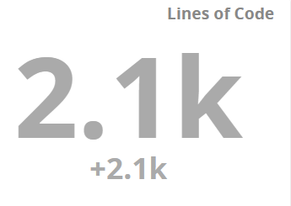
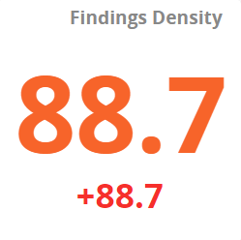
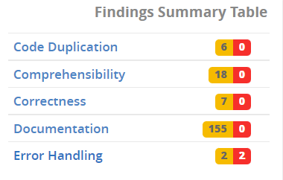
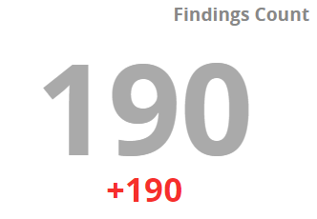
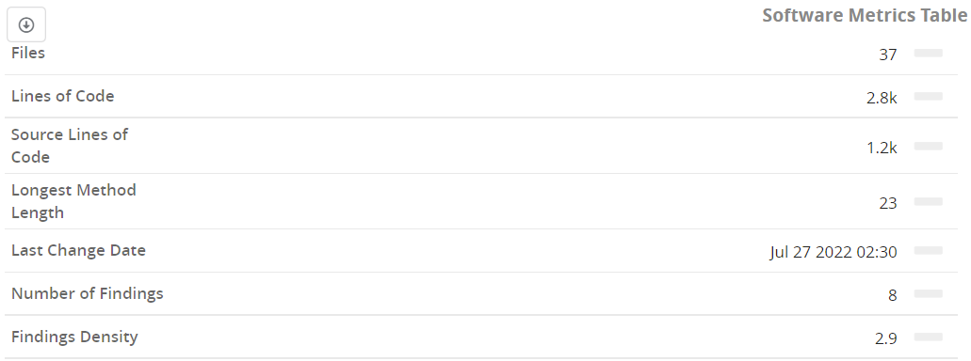
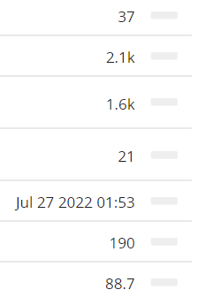
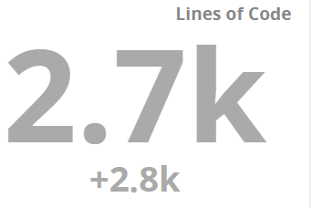
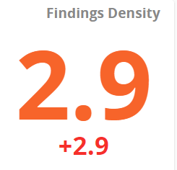
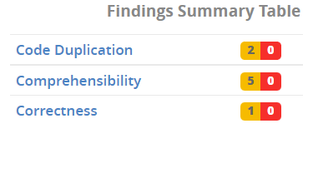
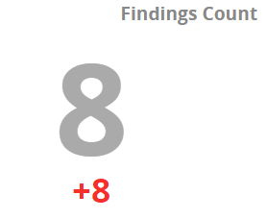
Software Comprehension and Maintenance
Manimaran Palani
Iphigenia Pappas
Heet Patel
Kevinkumar Patel
Venis Patel
Déjà Vu – Poster Presentation
Project Objective
Critical Decisions Made
Metrics used to Review
Software ISO/IEC 25010
Learning to make critical decisions through theory and practice of reengineering .
A candidate R from five different repositories chosen by respective team members.
The detailed analysis of the ‘undesirables’ in the repositories using TeamScale before tapering down to the candidate R.
The chosen candidate R provides us with the opportunity to reengineer the software program thus improving its maintainability.
Maintaining control over software modification.
Perfecting existing functions.
Identifying security threats and fixing security vulnerabilities.
Preventing software performance from degrading to unacceptable levels.
Files
Lines of Code
Source Lines of Code
Change Count
Number of Findings
Number of Findings (Red)
Number of Findings (Yellow)
Findings Density
Findings Density (Red)
Findings Density (Yellow)
Refactoring Results
Software Metrics
Before Refactoring
After Refactoring
Before Refactoring
After Refactoring
SOEN 6431 – Summer 2022
Professor. Dr. Pankaj Kamthan
Team C

